Slide 1
Thinkful Excel Capstone
Sunny Chen
Notes:
Hi. My name is Sunny and today I’ll be presenting my Excel capstone.

Slide 2
Goals
Maximize revenue and minimize costs for Lariat
Notes:
The strategies I will be talking about today revolve around Lariat’s goal of maximizing revenue and minimizing cost.

Slide 3
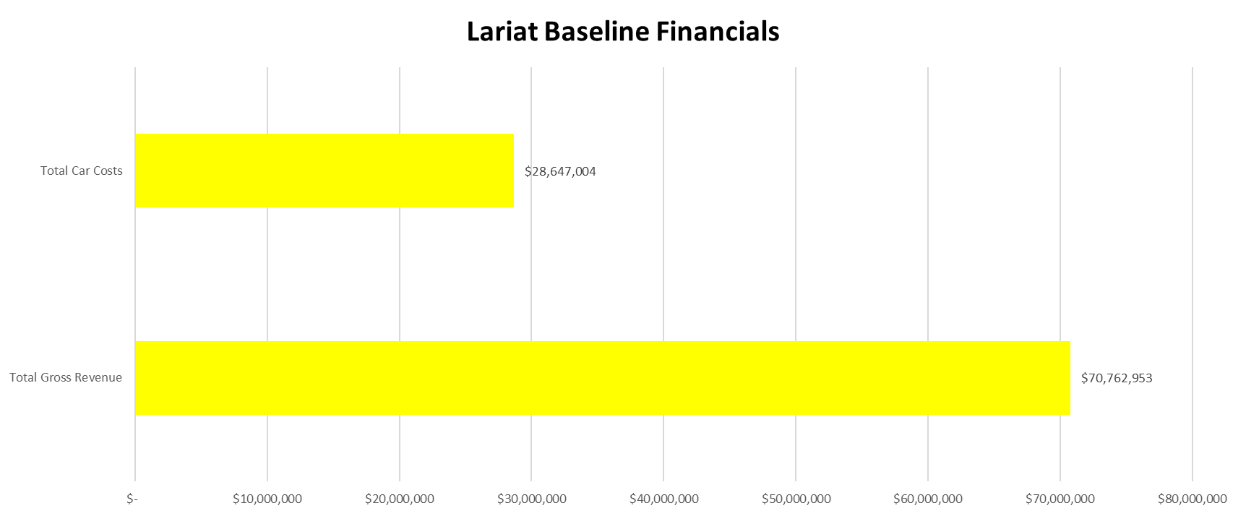
Lariat Baseline Financials
ROI = 2.47
Notes:
To start off, I’ll be presenting Lariat’s baseline financials that I had discovered from the raw data presented in Excel. These numbers were calculated by dividing the total costs and gross revenue by 11 and multiplying by 12. The reason is because the original total costs and gross revenue are based off 11 months, but we really want Lariat’s baseline financials for a total year, or 12 months. The car costs were calculated based on the monthly car costs and the insurance is assumed to be paid only once a year. As a heads up, I decided to use a standard of measuring the success of each strategy by using ROI, or return on investment, and comparing it to the baseline ROI.

Slide 4
Strategy 1
Offer discounts for branches with smallest demand
Notes:
Summarizing the first strategy, strategy is to offer discounts at branches with the smallest demand.

Slide 5
Strategy 1 Assumptions
As discount increases, demand increases twice the percentage
Notes:
I went by the assumption of discount increasing, demand will increase twice as much by percentage. So, if discount increases by 1%, then demand will increase by 2%.

Slide 6
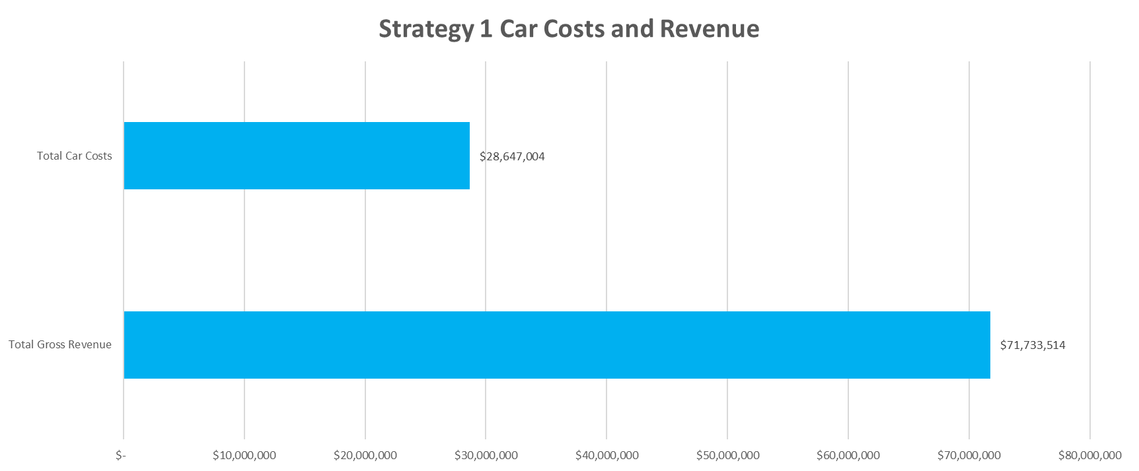
Strategy 1 Result
ROI = 2.50
Notes:
For the strategy 1 results, I calculated the results with discounts in the 10 lowest branches with the smallest demand. The percentage discount was 10% for each country. There were no discounts used for the rest of the branches. The total gross revenue did increase as a result, which led to a ROI of 2.50 when calculated. The car costs will remain the same as these discounts don’t impact how much Lariat will have to pay.

Slide 7
Strategy 2
Increase car price per day for age groups with higher percentage of accidents
Notes:
Now that we’ve looked into strategy 1, let’s look at how strategy 2 compares. Strategy 2’s approach is to increasing car price per day for age groups with higher percentage of accidents.

Slide 8
Strategy 2 Assumptions
As car price increases, demand decreases 70%.

Slide 9
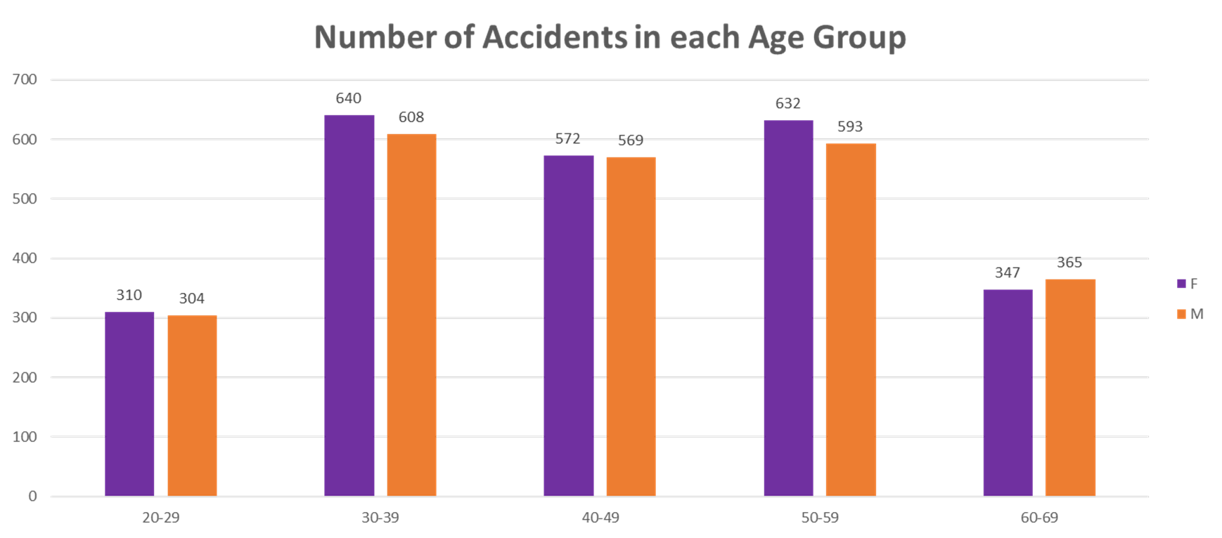
Notes:
Now here are the number of accidents in each age group, and is also divided by male and female. I understand in some age groups, there are more accident-prone people than others, but the best way to figure out which age groups are more accident prone is to find out the percentage of people relative to the total count.

Slide 10
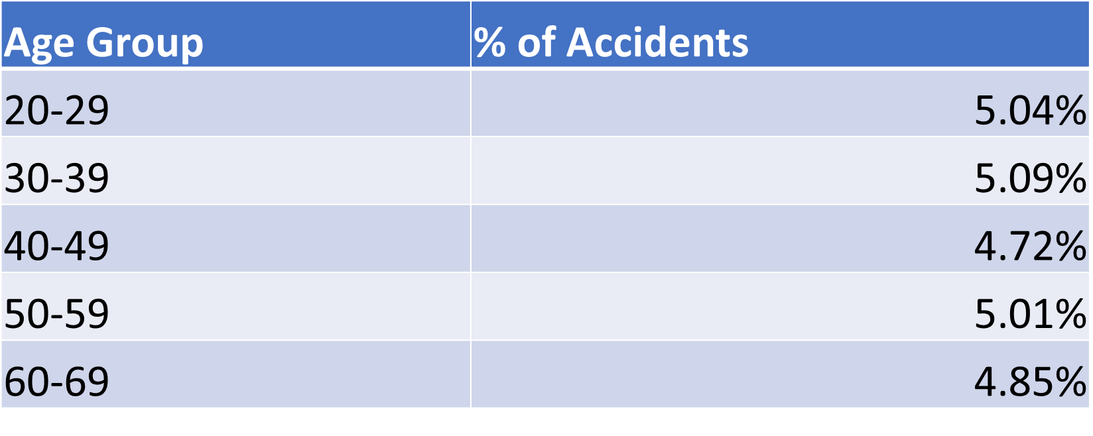
Percentage of Accidents relative to Total Count
Notes:
Now, here’s what I managed to calculate for percentage of accidents in each age group relative to the total count in each group. The numbers may have made the Age Group of 30-39 more accident prone by a lot, but it actually ended up calculating to 5.09% of the total people. So for my calculations, I chose to do the top 3 age groups that were more accident prone, which were the Age 30-39 age group, Age 20-29, and 50-59.

Slide 11
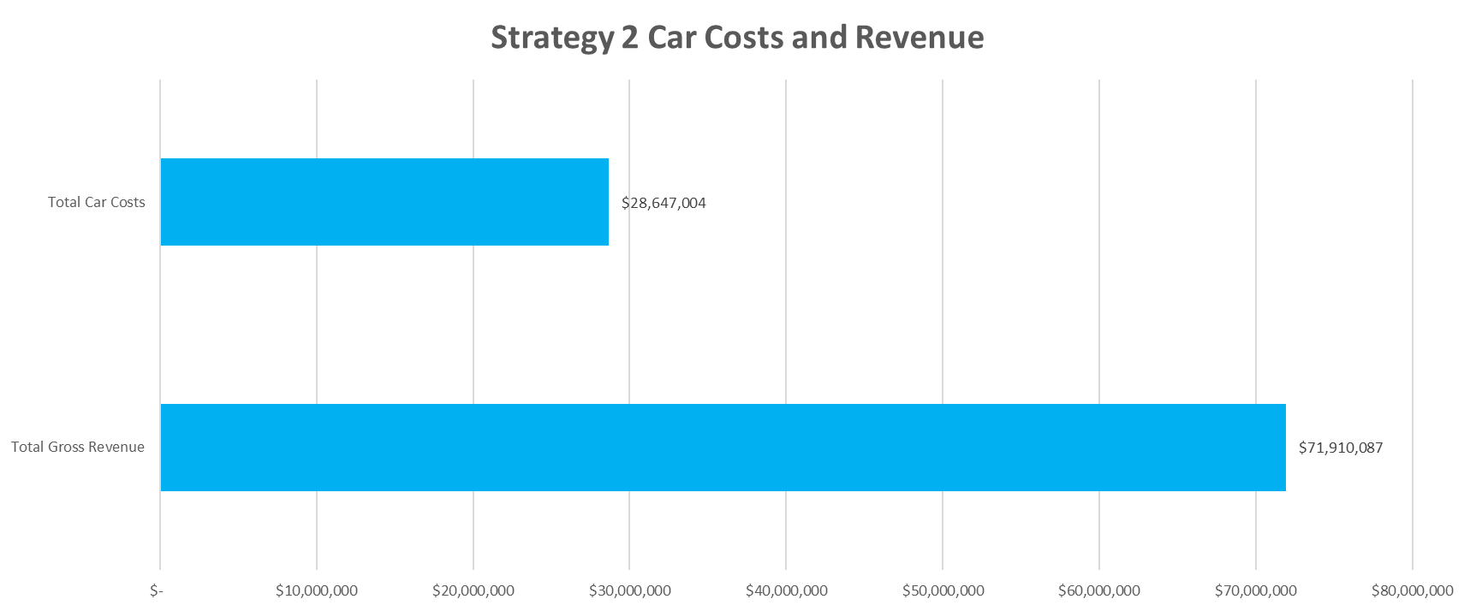
Strategy 2 Results
ROI = 2.51
Notes:
Now, unlike strategy 1, strategy 2 was given a different percentage of cost increase depending on the situation. I chose to increase the cost by different percentages because there were more people in some age groups than others.

Slide 12
Recommendations
Strategy 2
Generates higher ROI
Car costs will decrease with less accidents
Notes:
Now, after looking at the recommendations for both strategies, my recommendation is to use strategy. It has a higher ROI than Strategy 1, which means there is more benefit to the investment in the long run. Not only that, car costs will decrease with less accidents. The car costs will also decrease with demand decreases for age groups with higher tendencies because there will be less accidents.

Slide 13
Next Steps
Look into fixed costs in more detail
Notes:
Now that I’ve suggested that Lariat goes with recommendation 2, the next steps would looking into the fixed costs in more detail. These should be costs that could be within our control, such as the space of the rental.

